Slide 1
ROLL BALL ASSOCIATION OF ANDHRAPRADESH
Team members:
R.V.S. TEJA KRISHNA(17MIS7085)
K. KRISNA REVANTH(17MIS7057)
P.H.S ABHIRAM(17MIS7073)
K. VARUN TEJA CHOUDARY(17MIS7156)

Slide 2
Project scope and objectives
1.1 identify objectives and practical measures of the effectiveness in meeting those objectives.(i.e., how do we know we are successful?)
To maintain the details of the players who have registered for the competition, and to maintain their profile for each competition.
The player can register himself in the website with his details and can be able to view the details of the upcoming competitions.
The player will get a mail notification when there is any new competition is going to be held.
The purpose of the project is that to maintain unity in all the player who belong to the andhrapradesh state.
The stakeholders will be, the one who are registered as players in the website, web developers, payment clients, Association manager.

Slide 3
CONT’D
1.2 Establish a project authority(i.e., Who is the boss?)
The main authority of the project will belong to the officials of the association who are in recruitment team.
1.3 Stakeholder analysis-identify all stakeholders in the project and their interests
The stakeholders of the project will the players who register as a player and for some competitions and also the recruitment team who checks the registered players list and keep track on the registered player for the competition, payment client who keeps the payments successful when there is registration.
1.4 Modify objectives in the light of stakeholder analysis(i.e., what shall we do for the commitment of stakeholders to the project?)
Building a user friendly and easily made registrations for the players can commit the stakeholders to the project

Slide 4
CONT’D
1.5 Establish methods of communication with all parties(i.e., how do we stay in touch and informed?)
For the players who registered will get a mail notification regarding the actions they performed with the website that can be the new registration to the association as a player or the for the registration for the upcoming competitions.

Slide 5
Project Infrastructure
2.1 identify relation between the project and strategic planning
strategic planning sets up a comprehensive plan for every step of the way during project planning.
Planning undergoes the division of project in to modules. The modules in the project are registration module, login module, events module, payment module.
2.2 identify installation standard and procedures
The project should have effective objectives that are concrete and well defined.
2.3 identify project team organization
We need to set the team who are going to fit the project to meet its outcomes.

Slide 6
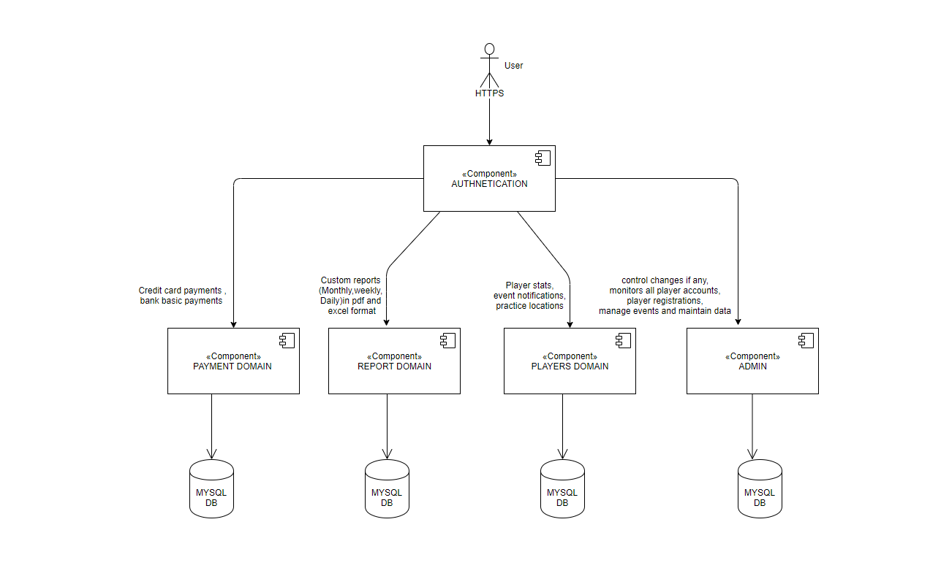
INFRASTRUCTURE DIAGRAM

Slide 7
SOFTWARE REQUIREMENTS
To create a web application we need a web editors like the Netbeans or some basic sublime text editor, xampp for databases etc.
To execute and view the outcome you will need to have the chrome or Microsoft edge for the execution of the code.
OPERATING SYSTEM | TECHINCAL REQUIREMENTS
WINDOWS | WINDOWS 7,8, and 10
MAC | Mac OS 10.12+
Linux | Ubuntu LTS releases 16.04 or later
BROWSER | TECHNICAL REQUIREMNTS
Chrome | V77+
Firefox | V68+
Safari | V12+
Edge | V44+

Slide 8
HARDWARE REQUIREMENTS
Processor (CPU) with 2 gigahertz (GHz) frequency or above
A minimum of 2 GB of RAM
Monitor Resolution 1024 X 768 or higher
A minimum of 20 GB of available space on the hard disk

Slide 9
THANK YOU

